Slide 1
ARCHANA EMMADI
EMPLOYEE ID: 152980
JAVA FULL STACK, MIPL

Slide 2
CAPSTORE APPLICATION

Slide 3
PROJECT REQUIREMENTS

Slide 4
Softwares:
1. Java 10
2.STS Version: 3.9.4.RELEASE
3.Eclipse Oxygen.3a (4.7.3a) platform
4. MySQL 5.5 Command Line Client
5. HTML 5
6.CSS 3
7.JavaScript
8. JSP
9.Spring Boot (2.0.4)
10. Spring Rest

Slide 5
Getting transactional
Details
MODULE

Slide 6
Getting Transactional Details
Customer can buy any item via any mode of purchase i.e. via online banking or through credit/debit card or through cash on delivery.
If the customer selects online banking correspondingly the account number of the customer will be collected, else if the customer selects card based on payment the card number and pin will be collected from the customer.

Slide 7
Transaction Table
Column Name | DataType | Constraint | Description
transactionId | int | Primary key
orderId | int | Foreign key
amount | double |  | Deals about transaction amount
modeOfPurchase | varchar2 |  | It tells whether mode of purchase is online banking,credit/debit card or cash on delivery
statusOfTransaction | varchar2 |  | It tells whether the transaction is successful or not

Slide 8
Bank Account Table
Column Name | DataType | Constraint | Description
bankId | int | Primary key
customerId | int | Foreign key
accountNo | big int |  | Customer account number
cardNo | big int |  | Debit or credit card number
balance | double
pinNo | int

Slide 9
Screenshots

Slide 10
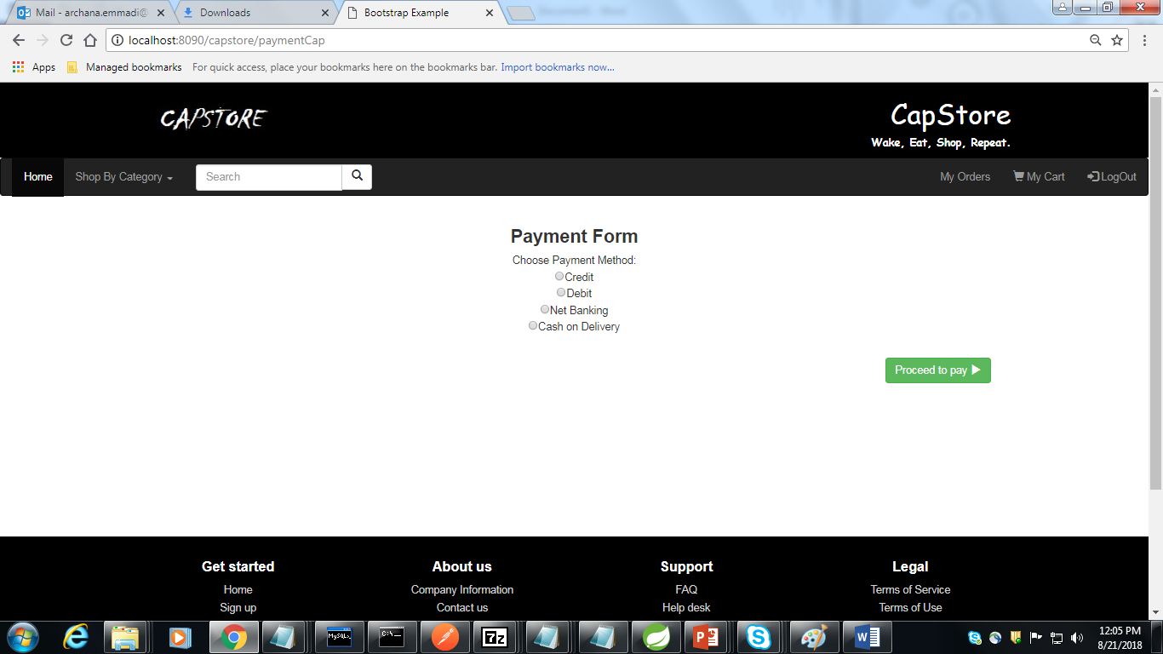

Slide 11
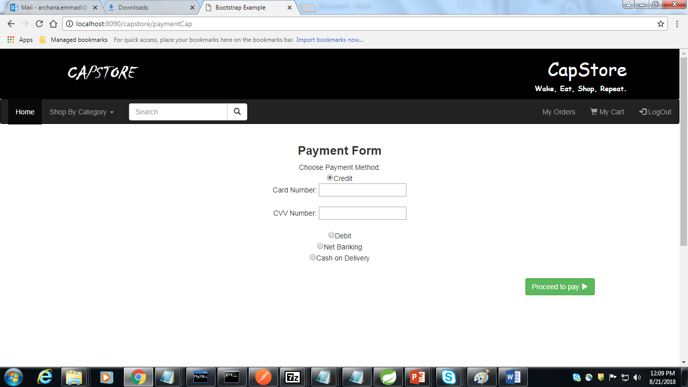

Slide 12


Slide 13
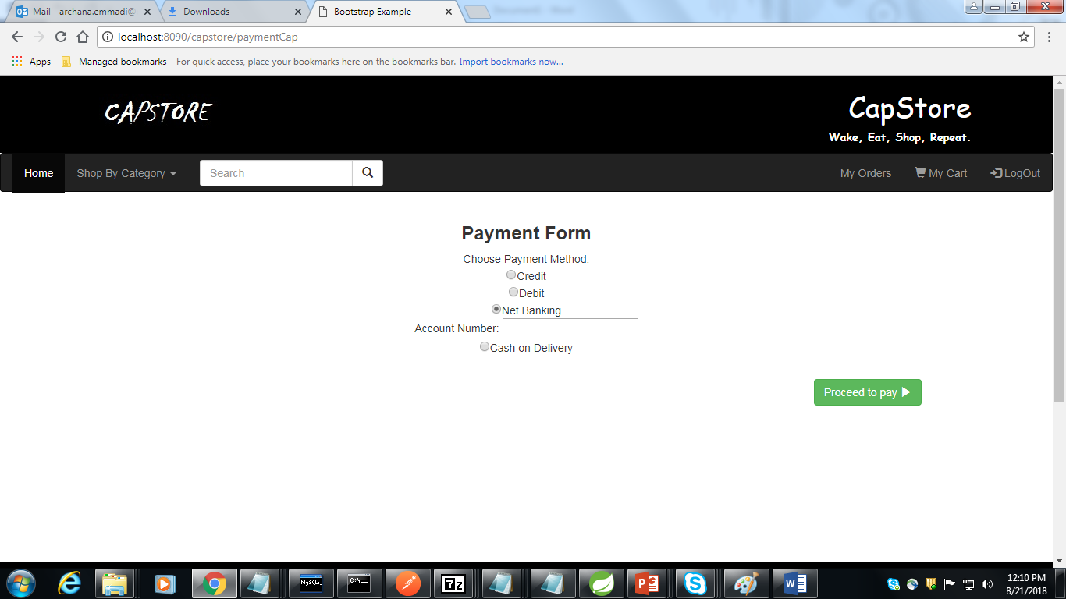

Slide 14
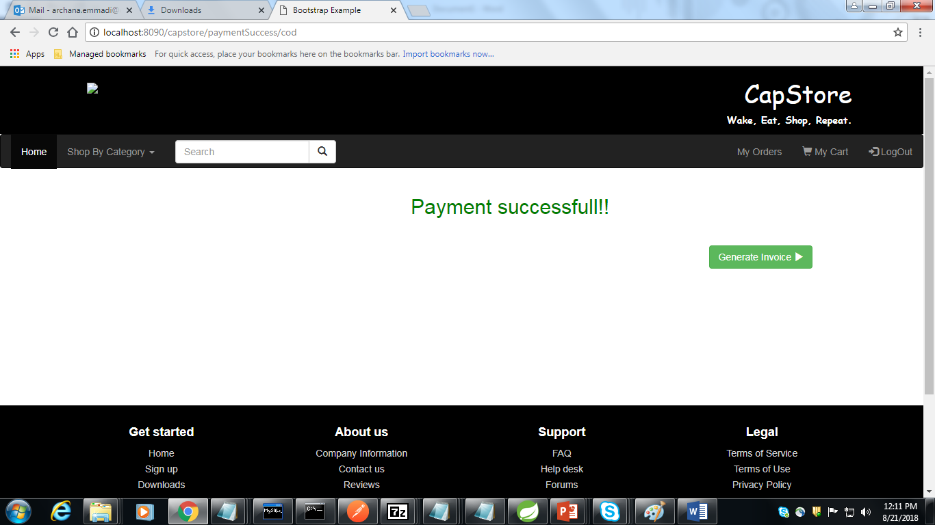

Slide 15
Thank You
Notes:
O Box atras do texto desnecessario. Deixar o layout mais simples.

